Slide 1

KHATRA ADIBASI MAHAVIDYALAYA
E-CONTENT
DEPARTMENT OF EDUCATION
SEMESTER-I (PROGRAMME)
SESSION: 2021-202 2
SUBJECT: EDUCATION
COURSE TITLE: PRINCIPLES AND PRACTICE OF EDUCATION
COURSE CODE: AP/EDN/101/C-1A
TOPIC: CONCEPT, SCOPE AND AIMS OF EDUCATION {Unit-I}
NAME OF THE TEACHER: AKINCHAN PAL

Slide 2
শিক্ষা ( Education)

Slide 3
শিক্ষা হল , সমাজের চাহিদা অনুযায়ী শিশুর উপর পরিণত ব্যক্তিদের সুপরিকল্পিত প্রভাবের সমষ্টি যা তার সুষম দেহমনের বিকাশের মাধ্যমে জীবনের পরম সত্যকে উপলব্ধি করতে সহায়তা করা ।
শিক্ষা কাকে বলে ? ( What is Education )

Slide 4
শিক্ষা – সম্পর্কে মনীষীদের উক্তি-
স্বামী বিবেকানন্দ-
শিক্ষা হল মানুষের অন্তর্নিহিত সত্তার পরিপূর্ণ বিকাশ সাধন ।
( Education is the manifestation of perfection already in man)

Slide 5
শিক্ষা শব্দের ব্যুৎপত্তিগত অর্থ-
‘ শিক্ষা ‘ শব্দটি এসেছে – সংস্কৃত ‘ শাস ‘ ধাতু থেকে । এর বহুবিধ অর্থ হল- শাসন করা , নিয়ন্ত্রিত করা , শৃঙ্খলিত করা , প্রশিক্ষণ দেওয়া।
Education শব্দটি তিনটি ল্যাটিন শব্দ ‘ Educare , Educere , Educatum ‘ থেকে এসেছে।
1. Educare- প্রতিপালন বা পরিচর্যা করা ।
2. Educere –নিষ্কাশন করা বা বের করে আনা ।
3. Educatum- শিক্ষাদানের কাজ বা নির্দেশনা দান ।

Slide 6
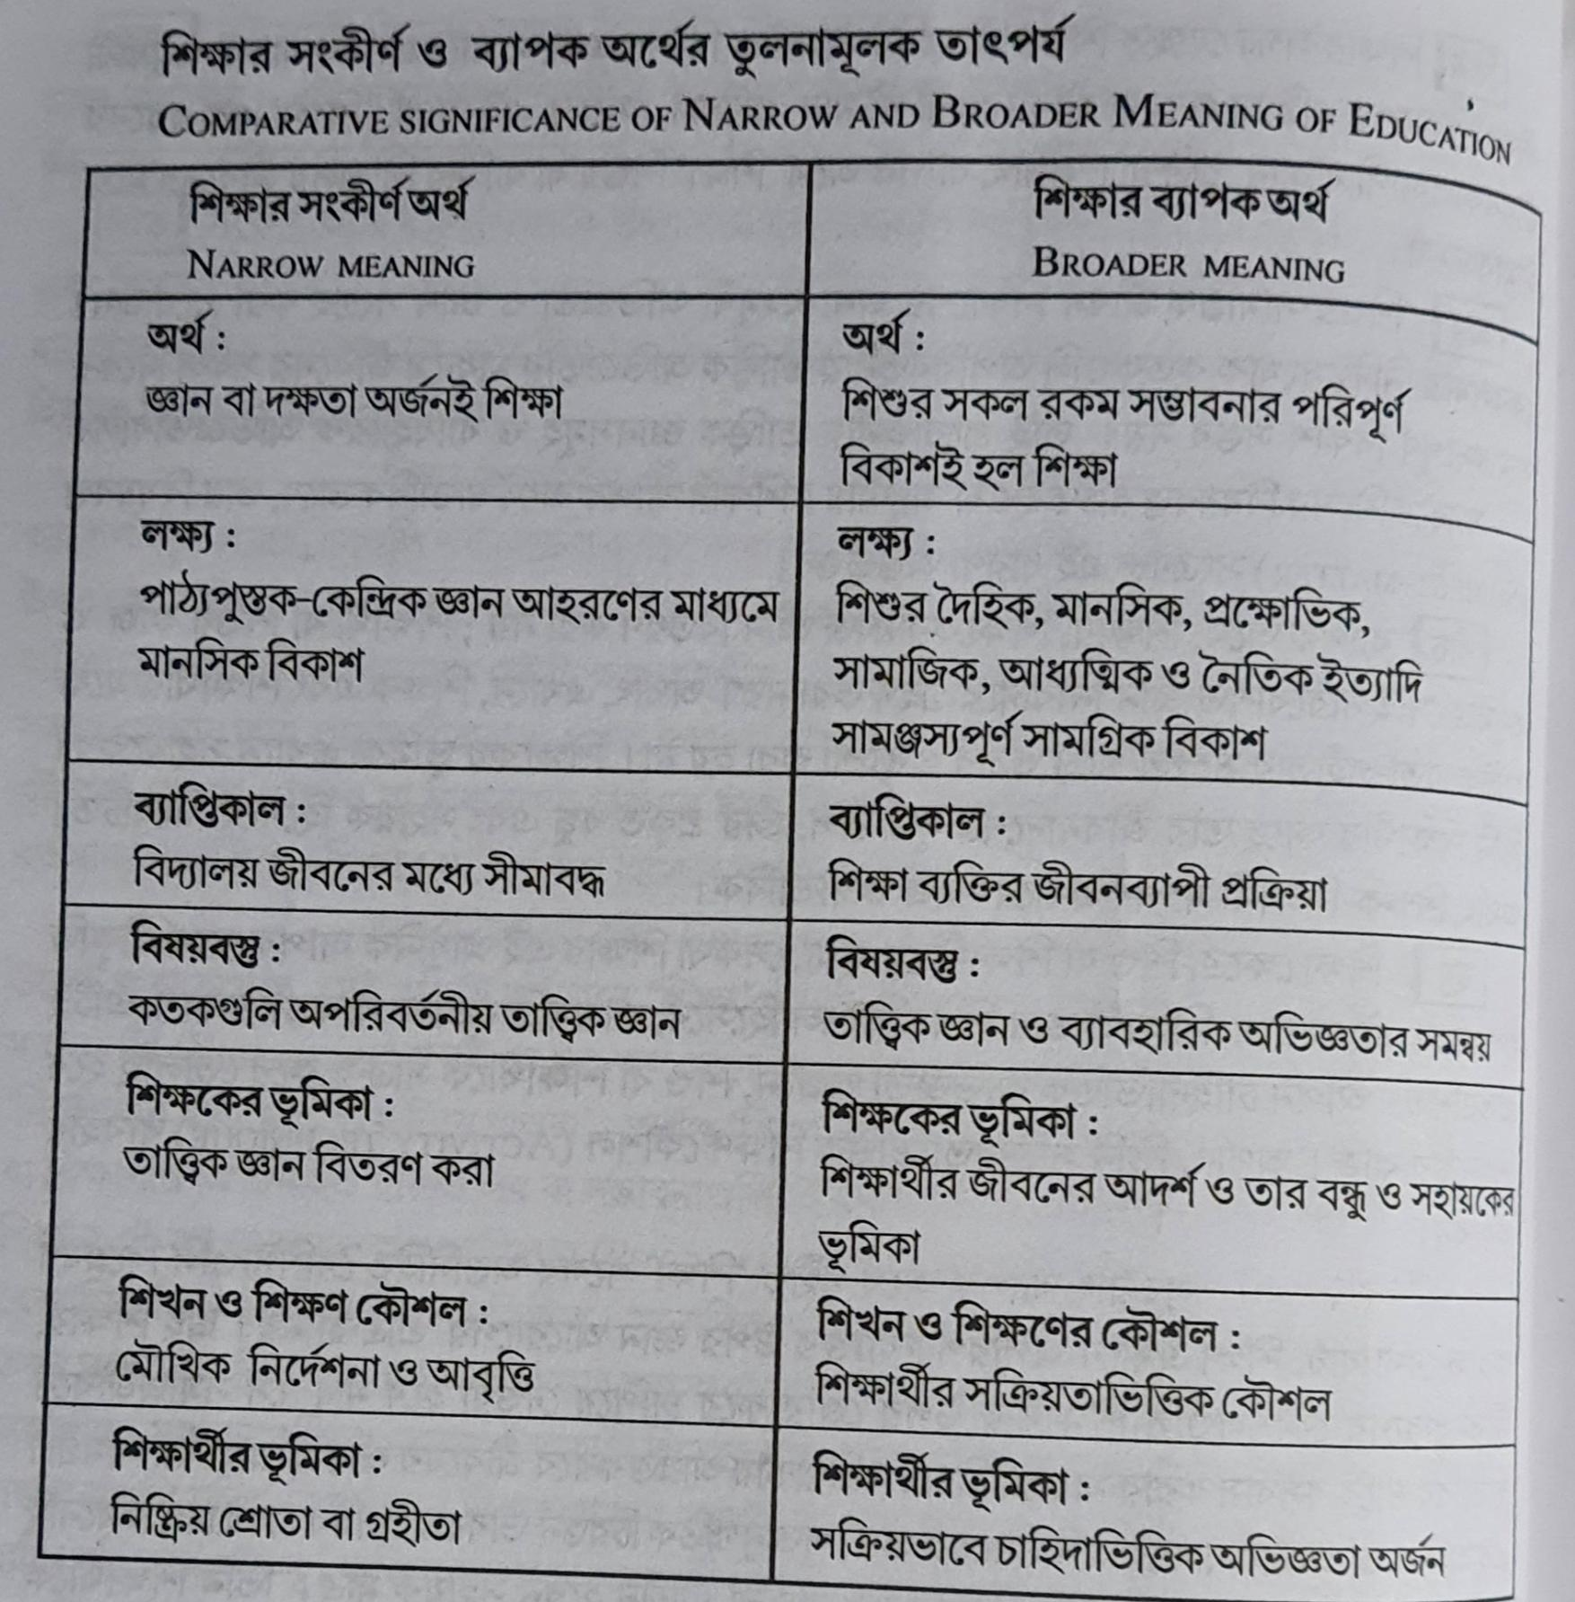

Slide 7
Aims of education: social and individual
“Education is not preparation for life; education is life itself.”
– John Dewey.
Education has become a necessity in every individual’s life. Without education, one would not be the person they grow up to become. Education aims at both social and individual improvement . While social aims focus on the development of society, individual aims focus on the development of individuality.
Social aims and individual aims are both important aspects of education. Education helps one in adopting acceptable behaviour and understanding their role in the society. One brings positive changes in themselves and the society by the education they receive. It is through education that an individual learns discipline and the basic etiquette needed to behave as a responsible citizen of the society. The values, beliefs, culture, religion, etc that have been followed since generations are transmitted to the next through education.

Slide 8
Social Aim of Education:
The main aim of education is the progress of society with time. Social aims of education gives importance to the development and needs of society. Education exists for society and the welfare of it. It makes the new generation familiar with the values, customs, beliefs, traditions, norms, behaviour patterns, etc followed since ages in the society. In the social aim of education, emphasis is attached to the welfare and growth of society. Humans work towards achieving the goals of the society and making it as desired. Society plays a significant role in the development of an individual. If there is no development of society, there is no development of humans as well. Therefore, the development of society is necessary for the development of humans.

Slide 9
Individual Aim of Education:
Individual aims of education emphasises on the development and improvement of individuality. Education aims to make an individual ready for the world and play their roles in society. Education helps in the physical, mental, and spiritual development of an individual. The character, personality, attitude, behaviour, thinking of an individual depends on the education they receive. Through education, individuals figure out their interests, strengths, weaknesses, specialities, potential and work towards improving in it as they mature.
Individual aim of education aims to make one self confident and self dependent. A person will be able to take risks, make decisions and solve problems on his/her own. The individual aim of education helps to achieve the highest degree of individual progress and development.

Slide 10
So, Both social aims and individual aims are important aims of education and are necessary in life. Education is a social necessity and an individual necessity. Working towards the development of society will automatically help in the development of an individual. For the progress of society, there should be development of individuals and vice versa. Hence, both social and individual aims of education are equally necessary.

Slide 11
THANK YOU

